Slide 1



Airplane Crashes Analysis
with PowerBI
Internship Project by HARSH GARG with Mentorness Batch –MIP-DA-06

Slide 2

Content
ABOUT THE PROJECT
DATASET DESCRI PTI ON
IMPORT THE DATA
CLEAN THE DATA
VISUALIZE THE DATA
FINAL DASHBOARD
ANALYSIS CONCLUSIONS
WHAT I LEARN

Slide 3
About the Project
This project analyzes airplane crashes (1980-2023) using Power BI for interactive visualizations.
Dataset includes crash details, fatalities.
Objectives: temporal/geospatial analysis, operator/aircraft performance, fatality trends, route analysis.
Deliverables: Power BI dashboards, reports. Aims to enhance aviation safety.

Slide 4
Dataset Description
Date: Date of the airplane crash.
Time: Time of the airplane crash.
Location: Location where the airplane crash occurred.
Aboard: Total number of individuals aboard the aircraft.
Aboard Passengers: Number of passengers aboard the aircraft.
Aboard Crew: Number of crew members aboard the aircraft.
Fatalities: Total fatalities in the incident.
Fatalities Passengers: Number of passenger fatalities.
Fatalities Crew: Number of crew member fatalities.
Ground: Casualties on the ground, if any.
Summary: Summary or description of the incident.
•
Operator: Operator or airline involved in the
incident.
Flight #: Flight number associated with the
incident.
Route: Planned route of the flight.
AC Type: Aircraft type involved in the crash.
Registration: Registration details of the
aircraft.
cn/ln: Construction or serial number of the aircraft.

Slide 5

Import the Data
Import Data as CSV File:

Slide 6
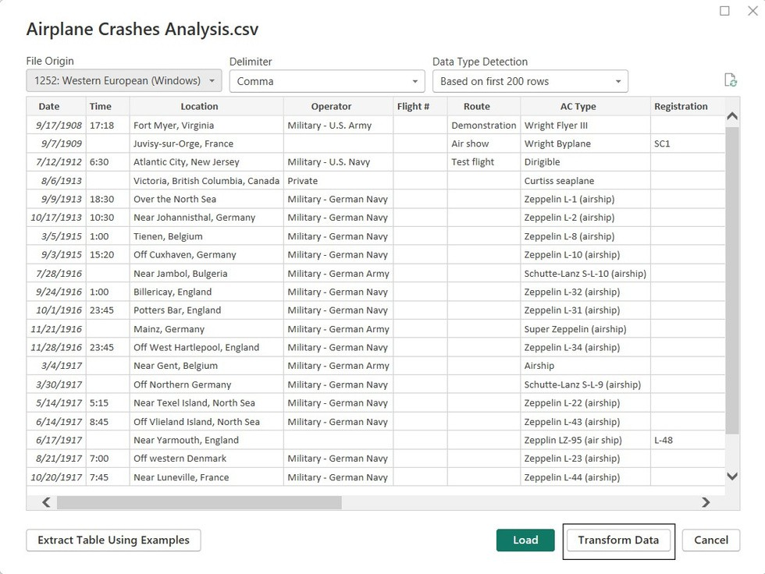
Clean the Data
Transform Data:

Slide 7
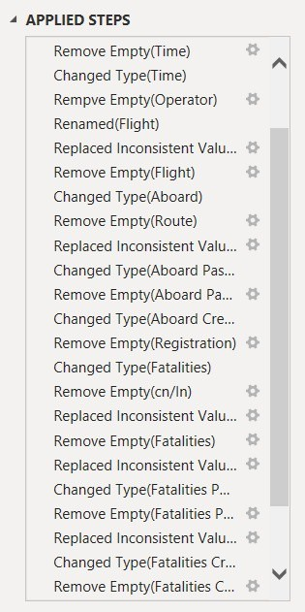


Clean the Data
Remove Empty Value.
Change Data Type.
Replace Inconsistent Value.
Rename Some Column.
Apply Change to visualize

Slide 8
Visualize the Data
Objectives:
1.Temporal Analysis 2.Geospatial Analysis
Operator Performance
Aircraft Analysis
Fatality Trends
Route Analysis

Slide 9
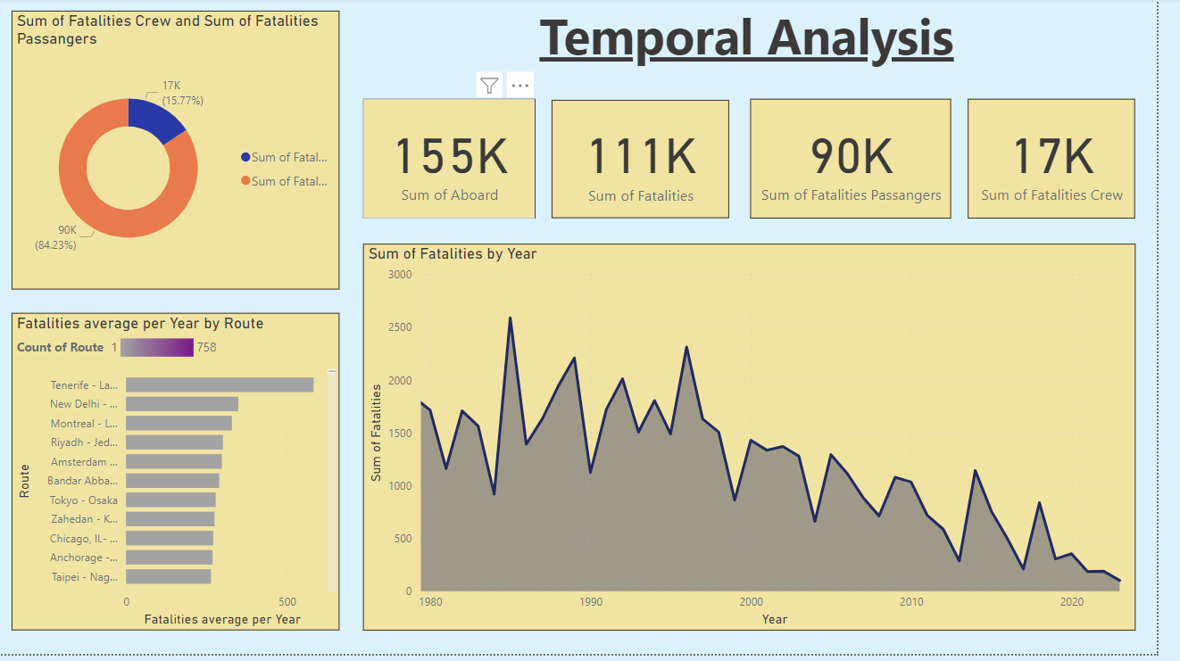

Slide 10
Geosțșatial
lyșÿș
6om of Fatalities by Country

Slide 11
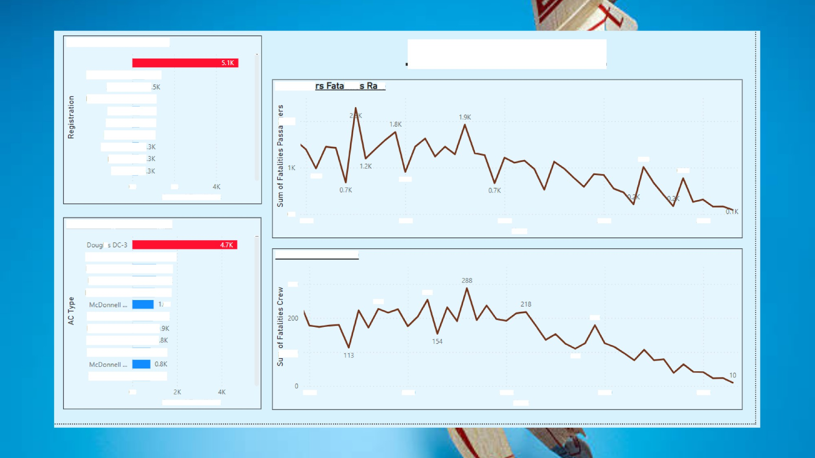







Fatality Trends
Fatal"ities by Registration
N736PA/PH -... JAB119 HZ-AIHMN—... | 0.6K 0 0.3K
K—jAV | 0.3K
VT—EFO | 0.3K
HZ-AHK | 0.3K
9M-MRD | 0
EP-IBU | 0
1.0K
15-2Z
0
1.OK
0.9K
D.8K
OK
2K
Sum of Fatalities
0K
1980
1W0
2000
2010
2020
Antonov An-...
Douglas DC-... Douglas C-47
Ilyushin IL-18B
1.ZK
1.1K
UK 1.OK OK
a.gK 0
0
OAK
300
Z27
Tupolev TU-... Douglas DC-4 de Havilland... Tupolev TU-...
179
11D
\’akovIev YA...
0.8K
DK
7980
1990
2X0
2010
2020
Sum of Fatalities

Slide 12
Analysis Conclusions
Chicago O'Hare, Illinois, especially along route (Chicago, IL- Los Angeles, CA), has the highest airplane fatality rate in the world.
The year 2001 was the highest airplane fatalities rate in the world.
There is a relationship between the Registration details of the aircraft
(N110AA), AC Type: McDonnell Douglas DC-10-10 and the number of fatalities.
There is a relationship between operator: American Airlines with number(46510/22) and the number of fatalities.
serial

Slide 13
What I Learn
How and when to use different type of visualizations.
How uncleaning data can make your visualization unreadable.

Slide 14

Thank You
BY :- HARSH GARG

